Slide 1

Advanced RF IC, Front-End Module, RF Active integrated Antenna (RFAiATM) and Wireless Sub-System Solutions
TM
RF Chips & Beyond
BHW Application Note #015
BHWL161 GNSS Full-Band High-Performance LNA in Super-Compact 1x1mm DFN with Relaxed Pin Pitch
Rev. 2.1
www.bhw-tech.com

Slide 2
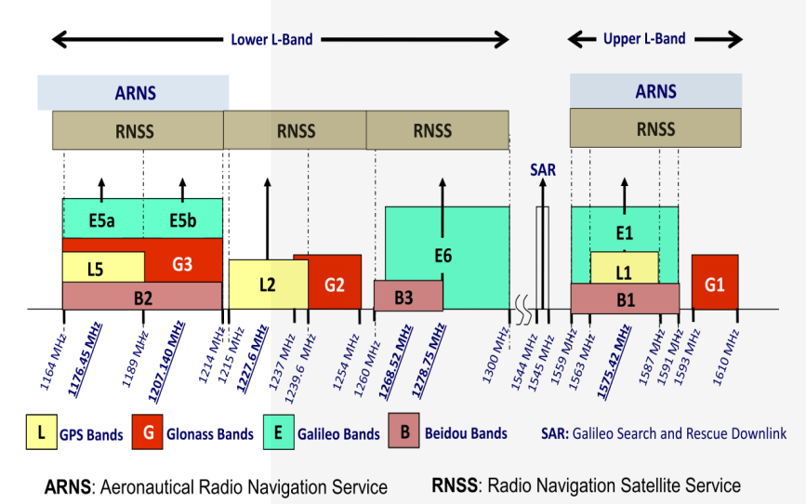
Background: Multi-Band High-Precision GNSS
BHWL161 is a wideband GNSS LNA for simultaneous coverage of all frequency bands (1165-1610MHz), all constellations with a single matching, providing lowest noise figure (NF~0.4/0.7dB) and highest-class linearity (Input P1dB~-3dBm) on the market today.

Slide 3
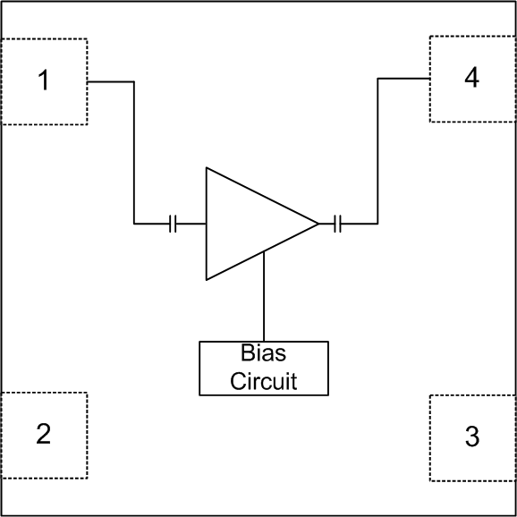

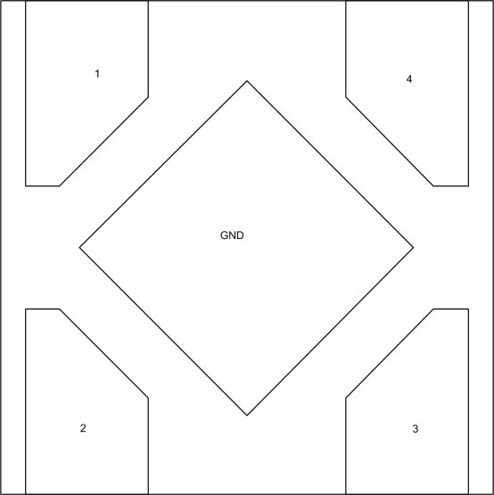
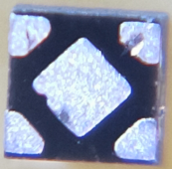
BHWL161 Wideband GaAs Low Noise Amplifier
Functional Block Diagram
Product Overview:
Advanced GaAs E/D-pHEMT Process
Ultra-Wideband 700MHz~2.5GHz Operational
Support Full-Band GNSS 1165~1610MHz
Ultra-Low 0.45/0.4dB EVB/De-Embedded NF at L1
Record-Low 0.3dB NF at L1 with Optimal Matching
NF <0.7dB at L1/L5; <0.8dB over Full GNSS Bands
Gain: 15.5/17dB (High/Low Band)
High Input P1dB: -3/-4dBm at 3.3/2.8V at 1575MHz
IIP3: ~+5dBm at Vdd=3.3V at 1575MHz
Adjustable Current: 1.5~7mA at 1.2~3.6V
ESD at All I/O Ports: 1kV HBM, >2KV CDM
Ultra-Compact 1.0x1.0mm DFN-4L Package
Relaxed Pin Pitch 0.65mm for Easy PCB Assembly
Package Pin-Out
(Top “See-Through” View)
Applications:
GNSS for Smartphones, Smart Watches, Wearables
GNSS for PNDs, UAVs and Drones
GNSS for Vehicles, ADS Systems
GNSS for Shared Rides, Asset Tracking
Active GNSS Antennas & Modules
UHF 600/700/868/915MHz Products
2.4GHz Angle-of-Arrival Systems
2.4GHz Remote Controls
Other Generic Radios from Sub-GHz to 2.5GHz
DFN-4L 1.0x1.0x0.45mm

Slide 4
BHWL161 High-Band EVB Noise Figure
Typical Noise Figure Over Different Vdd/Ven
Notes:
-Measured data included EVB feedline and SMA connector losses. Intrinsic LNA NF should be ~0.05dB lower
-The above data were taken from EVB optimized for Vdd=Ven=2.8V. NF and S-parameters at lower voltages can be further optimized if needed.

Slide 5
BHWL161 Full-Band EVB Noise Figure
Typical Noise Figure Over Full GNSS Bands
Notes: Measured data included EVB feedline and SMA connector losses. Intrinsic LNA NF should be ~0.05dB lower.

Slide 6
BHW RF Front-End AppNote Library
This is an abridged version of BHW AppNote #015. Please contact BHW Support or your local sales rep/distributor for a complete copy of the document and other related information.

Slide 7
BHW RF Front-End Solutions AppNote Library
In addition to standard datasheets and EVB/BOM info, BHW publishes an AppNote series that address various topics on RF front-end design and performance over a wide frequency range from 300MHz to 6GHz, as an effort to assist customers in developing cutting-edge, cost-competitive products:
BHW AppNote #001 - Cross-Over Cascade of BHWM253 to Boost Tx Power and Rx Sensitivity of 2.4GHz Systems
BHW AppNote #002 - Accurate Benchmark of GNSS CN0 Using the Power-Splitter Method
BHW AppNote #003 - Boosting Wi-Fi Tx Power and Rx Sensitivity with BHWA251 and BHWM252
BHW AppNote #004 - UHF 900MHz RF Front-End Solution Using BHWA251 Half-Watt PA and BHWL160 Sub-1dB-NF LNA
BHW AppNote #005 - Sub-1GHz Applications of BHWA350 2-in-1 Wideband Fully Matched Amplifier
BHW AppNote #006 - Low-Noise High-IIP3 LNB Architecture for Dual-Band High-Precision GNSS Using Cascade of BHWL160
BHW AppNote #007 - UWB RF Front-End Solution Using BHWA350 and BHWM552
BHW AppNote #008 - High-Power 5.8GHz RF Front-End Solution Using BHWA555 and BHWM552 for ETC, V2X and Wireless Video
BHW AppNote #009 - 5.8GHz RF Front-End Using BHWA350 and BHWM552 for Wireless Audio
BHW AppNote #010 - Multi-Constellation GNSS Active Antenna Using BHWL161 Cascade and Single-Fed Dual-Band Antenna
BHW AppNote #011 - BHWL161 Super-Compact Low-Power Low Noise Amplifier for Range Extension of 2.4GHz RC and IoT
BHW AppNote #012 - Enabling Cost-Effective High-Precision GNSS Using BHWL161 and Linear-Polarization PCB Antenna
BHW AppNote #013 - GNSS Noise Floor vs Receiver Architecture
BHW AppNote #014 - Designing Ultra Low-Power High-Performance GNSS Products Using BHWL160 GaAs PHEMT LNA
BHW AppNote #015 - BHWL161 GNSS Full-Band High-Performance LNA in Super-Compact 1x1mm DFN with Relaxed Pin Pitch
BHW AppNote #016 - Improving GNSS NF Measurement Accuracy Using Broadband LNA BHWL161 as Pre-Amp
BHW AppNote #017 - High-Efficiency, Low-NF 2.4GHz Front-End Solution for IoT Using BHWA251 and BHWM252
BHW AppNote #018 - Optimizing BHWA555 Wideband One-Watt PA for Long-Range 5.8GHz Transmitter Applications
BHW AppNote #019 - Miniature 2.4GHz RF Front-End with Integrated Chip Antenna and BHWM253 for TWS and IoT
BHW AppNote #020 - Multiplying the Range for 2.4GHz Music Streaming with BHWR250L Active Integrated Antenna (AiA)
BHW AppNote #021 - Range Extension for 2.4GHz Wireless Systems with BHWR250M Active Integrated Antenna (AiA)
BHW AppNote #022 - Enabling Long-Range Angle-of-Arrival for High-Precision Indoor Positioning with BHWR250N RF AiA
BHW AppNote #023 - Extend the Range for 5.8GHz Audio/Video Streaming with BHWR580M Active Integrated Antenna (AiA)
BHW AppNote #024 - Improving 5.8GHz Radio Link Budget with BHWR580L Active Integrated Antenna (AiA)
BHW AppNote #025 - Improving Range and Throughput of 2.4GHz Wi-Fi with BHWR250 Array Antenna
BHW AppNote #026 - Improving Range and Throughput of 5GHz Wi-Fi with BHWR550 Array Antenna
BHW AppNote #027 - Multi-Band High-Accuracy GNSS Solutions Using BHWP150 DFN1x1 Ultra-Compact Power Divider & Combiner
BHW AppNote #028 - Use BHWM252 Cascade to Extend Range of 2.4GHz Wireless Systems with Single-Port SoCs
BHW AppNote #029 - Improving Range of 2.4GHz Wireless Microphones and Audio Systems with BHWR250A Active Integrated Antenna (AiA)
BHW AppNote #030 - Simultaneous Improvement in Range and Battery Life of 2.4GHz Wireless Systems with BHWR250M AiA
Contact support@bhwtechnologies.com or BHW distributors/representatives for your copy of the above and new up-coming documents.

